Slide 1






Twitter Bot
Detector
Project Mentor:Mrs. Pooja Malik
Team: Jain-Win
Members:
Arham Jain
Dhruv Sharma
Diya Dugar
Mudit Gupta
Nimansh Endlay
Raj RS Bisen
project created as a part of the
Smart SNU Hackathon

Slide 2
Decision Tree
Classifier Analysis
Tech Stack:
Python, Flask, Vanilla JS
and CSS
Libraries
SciKit, Pandas, NumPy
Pros:
Interpretability
Feature Importance

Slide 3
Model Stats
97%
82%
80%
10%
Max Accuracy Achieved
Average Accuracy
Testing Accuracy
Average %
false positive

Slide 4
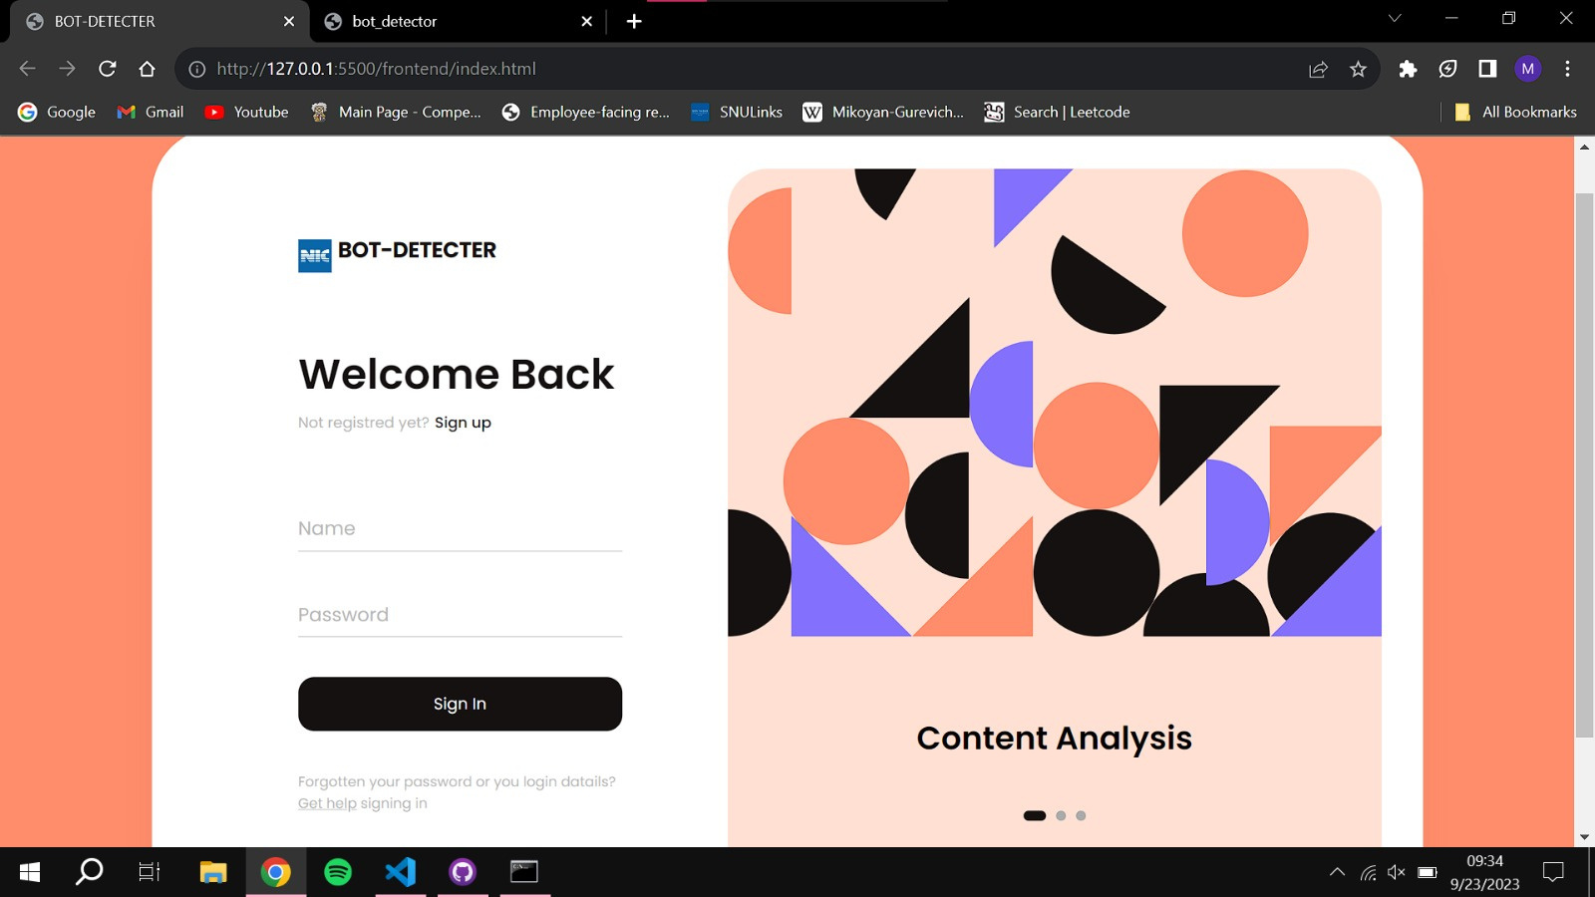
Login Screen

Slide 5
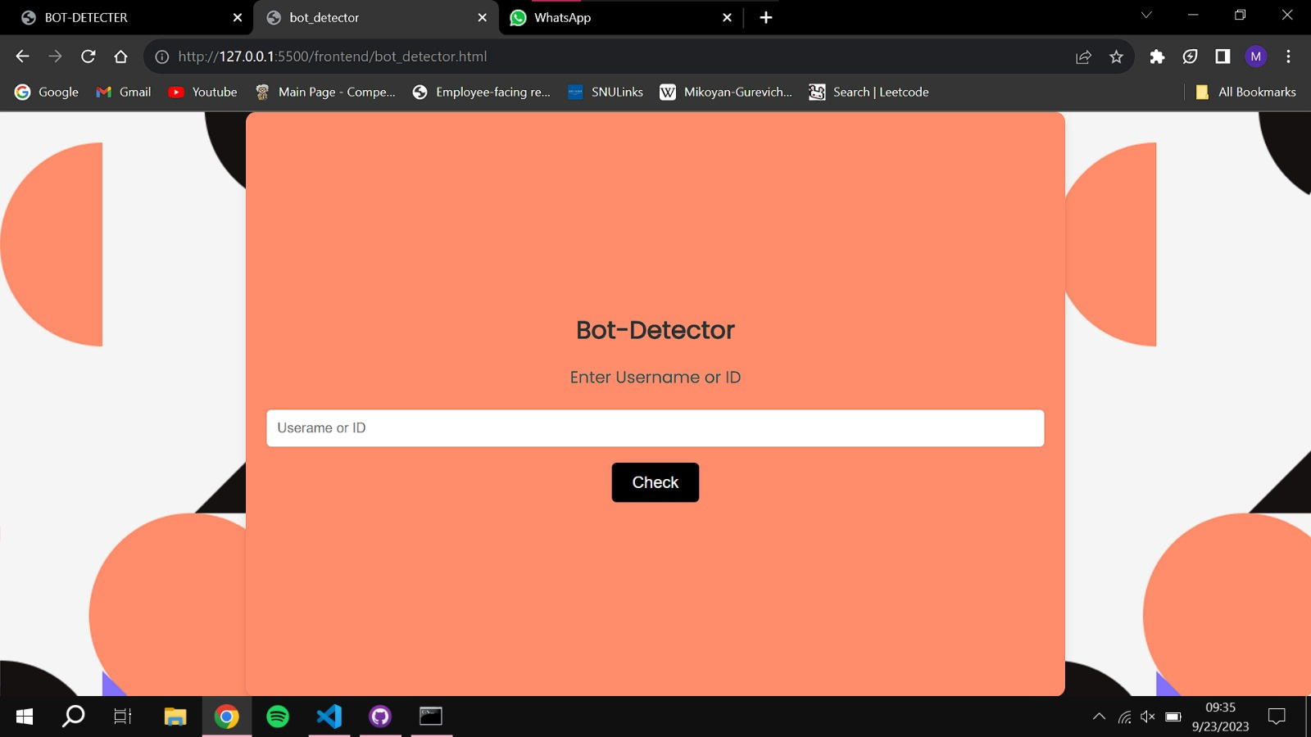
Access Screen

Slide 6


Fast Model Training
Good Overall Accuracy
Login window
to handle .gov
access
Web Scraper
to access profile data

Slide 7
Thank you

